Slide 1
AXIS UK Gender Pay Gap Reporting
As at 5th April 2021

Slide 2

Introduction
AXIS Specialty Europe SE publishes its gap in gender pay in line with government regulations that came into force in 2018. Although as of 2020, our AXIS UK Services Ltd entity is no longer in scope of the regulations, we have chosen to continue to disclose our gender pay gap for this entity along with a combined analysis for both UK entities in order to show an overall view of the gender pay gap across our UK population.
The gender pay gap measures the difference in pay between all males and females, regardless of role. It is not therefore a measure of pay equity, in that the purpose of the gender pay gap is not to compare the pay of employees delivering like for like work.
Our analysis shows that we have a gender pay gap. While our gap has reduced year over year in most metrics, it remains too broad and in some metrics the gap has widened slightly. The biggest driver of our gender pay gap remains the higher representation of male employees in our most senior, and therefore highest paid, positions in the UK. In order to reduce the gap, we are continuing to make every effort to improve gender representation across the organisation.

Slide 3
Our Numbers – AXIS UK Gender Pay Gap April 2021
¹ The gap in median hourly pay is due to an increase in male representation in our Lead Professional roles as a result of hiring activity. The gap in pay between males and females at this level is closing and we are working hard to improve the diversity of candidates for all roles in the organisation.
² The gap in bonus pay participation is driven by the eligibility of males and females during our year end annual incentive review. Eligibility is driven by date of hire, with more females in this snapshot hired after the eligibility cut off date. In reality, only 4 eligible individuals did not receive an annual incentive across AXIS UK due to performance or having already tendered their resignation.
³ The gap in mean and median bonus pay participation for AXIS UK Services Ltd is driven by the realignment of annual incentive award date for this entity, which resulted in both 2019 and 2020 annual incentive awards being paid during the snapshot period. Based on only the 2020 annual incentive awards, the gap would have reduced year over year to 57.9% and 50.0% respectively.
¹
³
²

Slide 4
Steps We Are Taking
We know that to reduce our gap we need to attract and retain more women, particularly in leadership positions and we have plans in place to help us achieve this. Our most recent actions include partnering with Inclusivity to run a women’s return-to-work programme, establishing a Women’s Employee Resource Group to act as a partner to our global Diversity and Inclusion Council, and implementing leadership coaching and mentorship programmes to prepare and support internal candidates for mobility opportunities.
These activities complement the existing initiatives within our global Diversity and Inclusion programme, aimed at building a more diverse and inclusive organisation. We recognise the valuable role that data plays in helping to drive greater diversity within AXIS, not least as it enables us to benchmark and measure progress. Therefore we are pleased to have been included in the Bloomberg Gender Equality Index for 2021 and 2022, which recognises our group’s commitment to gender equality through policy development, representation, and transparency.
“I am proud to work for an organisation where commitment to diversity and inclusion is part of the daily conversation. There is a level of authenticity and honesty at AXIS; we recognise we have work to do and are constantly striving to do better. The foundations have been set through the introduction of employee-driven groups, the D&I Council and local Advocates groups established in 2020 and more recently Employee Resource Groups.
We are confident that our focus on gender equality will result in long term business benefit, bringing diversity of thought which will lead to a more innovative and dynamic organisation”
- Seema Bradbury, Co-Chair Diversity & Inclusion Council.

Slide 5
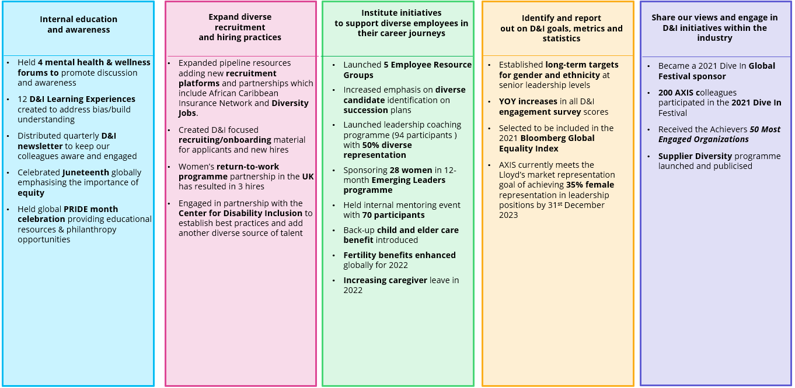
Our Journey: 2021 Global D&I Initiatives

Slide 6
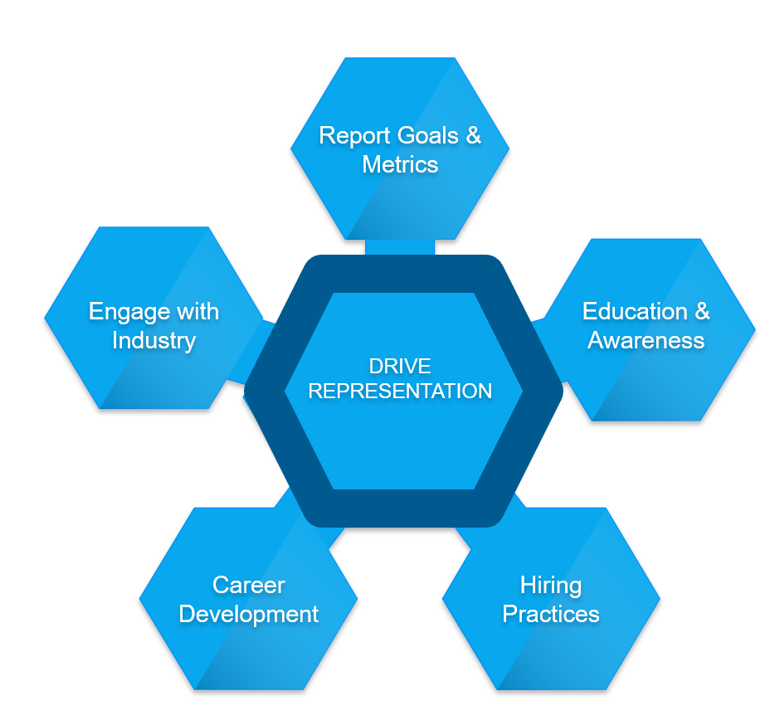
2022 Global Focus Areas
To ensure we continue to make progress, the focus of our Diversity & Inclusion strategy over the coming year is to drive a more diverse representation across our organisation.
Establish, share and achieve 2022 gender and ethnicity senior leadership representation targets.
Lead a self identification campaign to encourage and support employees in disclosing gender & ethnicity data.
Develop and implement process to internally report AXIS representation benchmarks and progress against those benchmarks twice annually.
We will share our views and engage in D&I initiatives within the industry to demonstrate our commitment to D&I.
Increase AXIS participation in Dive In through ERG promotion and engagement
Participate/sponsor targeted organisations’ programmes to establish AXIS commitment to D&I in the industry (NAAIA, Lloyds)
Engage with external partners (e.g. ACIN, Inclusivity) to establish the AXIS brand and build awareness of AXIS as an employer that champions D&I.
Understand the obstacles and create strategies to garner support for a diverse and inclusive environment
Hold annual D&I Forum In collaboration with ERGs
Continue offering monthly D&I Learning Experiences
Distribution of quarterly updates to AXIS managers which will include: 1)Key upcoming D&I events to engage in 2) Past event highlights/outcomes
Identify the most successful methods for expanding the number of diverse/nondiverse employees moving into new career opportunities
Host annual mentor event
Create, share, promote a well-defined menu of development options to managers and ensure their awareness of the programmes (e.g. Women’s Emerging Leaders, Women’s Insurance Breakfast Club, EZRA 1:1 coaching, etc.)
Expand diverse pools of talent through internal development, diverse school and organisation relationships, establishing diverse recruitment platforms and sourcing via AXIS colleagues’ networks.
Monthly link of open leadership positions is sent to D&I Council and ERGs to share with their social media networks. Analytics on our level of sharing will be reported quarterly.
Identify additional resources to broaden our pool of diverse candidates for open roles

Slide 7

Our Global D&I Philosophy
At AXIS, we have built an organisation grounded in the strength of our talent. We see diversity as a strategic imperative that is core to our business and to our culture. This is because we believe that diversity enriches our perspective. By embracing our diverse backgrounds, we will be able to deliver on our Company’s aspiration to be bold, take risks, think big, and deliver value to our clients and communities.
We don’t just celebrate our differences, we learn from them, because we know that we are better together. This includes striving to create an inclusive and welcoming culture where employees of all backgrounds and from all walks of life feel comfortable and empowered to be themselves. This means that we bring our whole selves to work. We have authentic encounters and conversations. And yes, we have equal opportunities to contribute, build, grow, and advance.
We value and seek people that reflect the diverse world in which we live and work - it makes us stronger as a team, as a Company, and as an emerging leader in specialty insurance and reinsurance.

Slide 8


We confirm that the data reported is accurate
Claire Butler
Director, AXIS UK Services Ltd
Tim Hennessy
Director, AXIS Specialty Europe SE

